Slide 1
INTRODUCTION TO GRAPHIC DESIGN
Graphic and Web Design Class

Slide 2
Meaning of Graphic Design
Graphic design is a craft where professionals create visual content to communicate messages.
Graphic design is not just about making things pretty, it is about using design principles to communicate a message clearly.
Graphic design is the art and practice of planning and projecting ideas and experiences with visual and textual content.
We’re all visual creatures and graphic design is the result of that! All of its principles and elements are created to best appeal to our eyes.

Slide 3
Meaning of Graphic Design

Slide 4
Uses/Importance of Graphic Design
It plays a great role in communication:
Graphic Design speaks to customers when you are not verbally speaking to them. Looking at a product, logo, banner or website you get a visual message.

Slide 5
It plays a great role in communication

Slide 6
Uses/Importance of Graphic Design
It gives you a consistent look:
Through graphic design, you can give a unique, customized touch to your brand. For it to be professional, the colors, fonts and logo across all media have to be uniform. This in turn keeps your brand message similar on all the platforms and people can connect with your brand.

Slide 7
Uses/Importance of Graphic Design
It leads to higher conversions:
Good designs have always been overlooked. But as a matter of fact, a good design which is professional and attractive can attract an audience to your site and tempt them to purchase your product. A great design can convert a business from no sales to a lot of sales.

Slide 8
It leads to higher conversions

Slide 9
Uses/Importance of Graphic Design
It sets you apart from the rest:
People like to associate themselves with good looking things. So, it is important that you choose the right design to set yourself apart from other competitors and convince your audience about their choices. The quality graphic design significantly increases your chances to stand out in the market and among audiences.

Slide 10
It sets you apart from the rest

Slide 11
Uses/Importance of Graphic Design
It shows professionalism:
The presentation can actually make your business a great one. People tend to look for companies that are trustworthy and seem professional. Graphic design is a great way to convince people who are looking for signs of professionalism. This develops a perception in their minds about your company and they invest in it.

Slide 12
It shows professionalism

Slide 13
Types of Graphic Design
Brand Identity Design:
Brand identity is like a human identification document. As an individual, you have a photo, home address, phone number, fingerprints, and more that set you apart from other people. In a similar manner, a company needs to have a unique set of visual elements or graphic representations to set itself apart from the rest of the crowd.
This involves designing a logo, typography, color schemes, and visual elements that reflect a brand’s personality. The goal is to create a coherent and appealing brand identity that will resonate with the target audience.

Slide 14
Brand design
Designing logos and setting clear guidelines for how they’re to be used.
Designing letterhead, icons, and various illustrations
Selecting brand colors.
Creating or selecting fonts and typography guidelines
Creating templates that follow the brand guidelines and can be used by marketing, growth, and other teams
Packaging design and graphics for product design

Slide 15
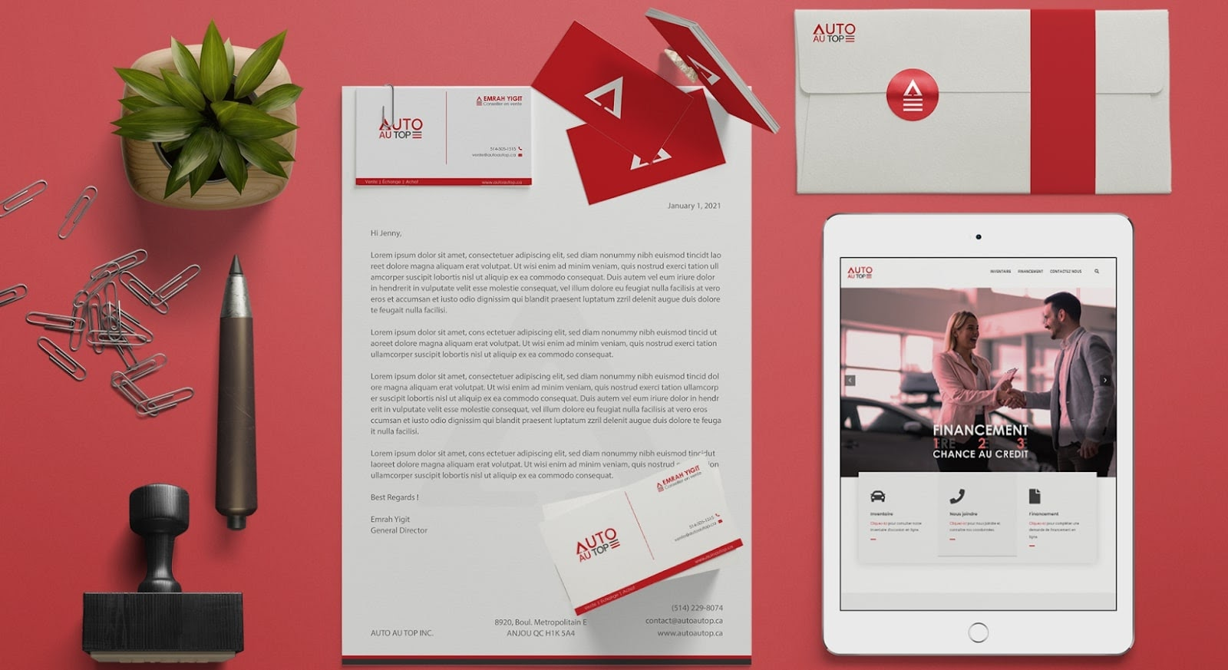
Brand design

Slide 16
Types of Graphic Design
Marketing/Promotion design:
Marketing design is graphic design for marketing initiatives. This type of design is used to create various promotional materials like brochures, flyers, posters, banners, social media ads, and more. The goal is to attract, engage, and persuade the target audience. All while staying true to the brand guidelines and visual identity.

Slide 17
Marketing/Promotion design
Create social media posts
Design ads for social media and web
Conceptualize infographics
Design on-brand headers, illustrations, and newsletters
Create flyers, posters, brochures, and business cards

Slide 18
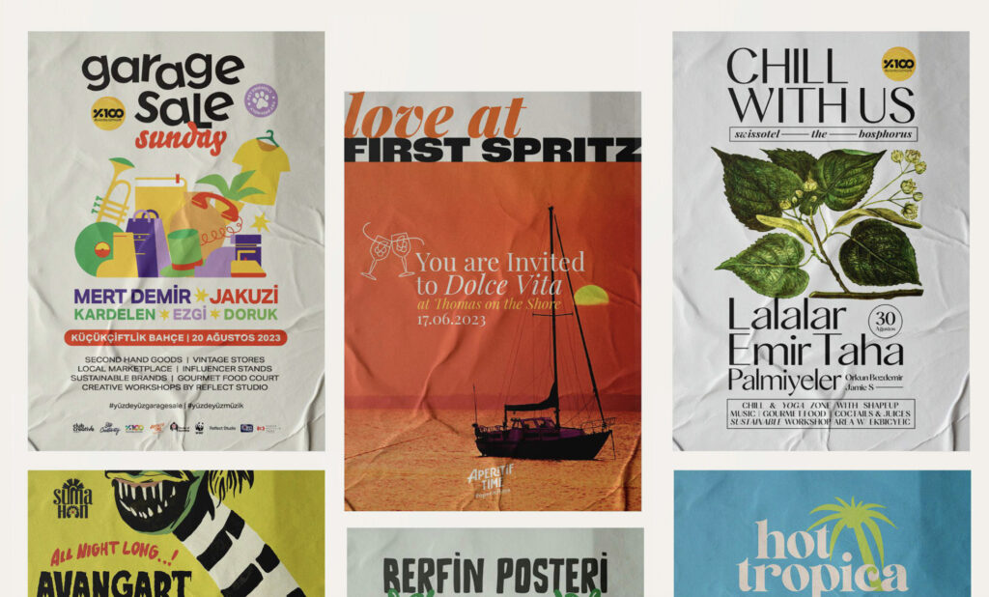
Marketing/Promotion design

Slide 19
Types of Graphic Design
Web/User Interface design:
Designing a great website is a multidisciplinary undertaking because websites are interactive, rather than fixed assets like a brochure or a magazine. This involves creating user-friendly and visually appealing interfaces for websites, mobile apps, and other digital platforms. Good UI design enhances user experience and usability.

Slide 20
Web/User Interface design
Create a wireframe and UI design for the website
Design and handpick elements like logos, colors, and fonts
Construct appealing and user-friendly websites.
Create and place buttons, calls to action, scrolling animations, and videos
Optimize website elements for all screen types

Slide 21
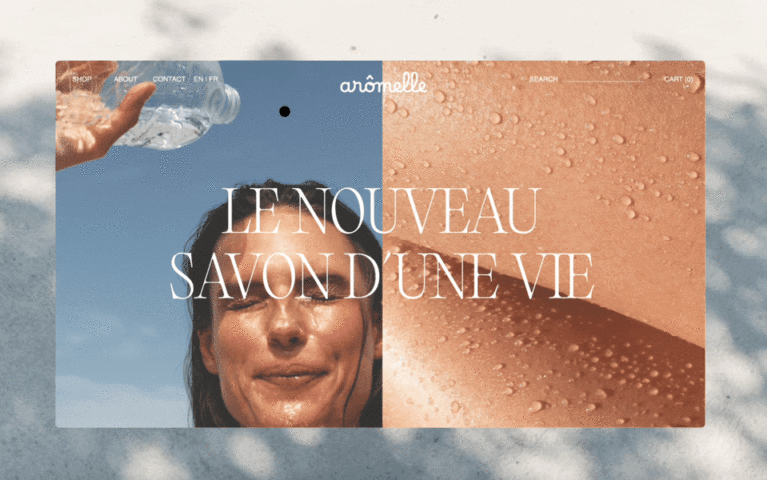
Web/User Interface design

Slide 22
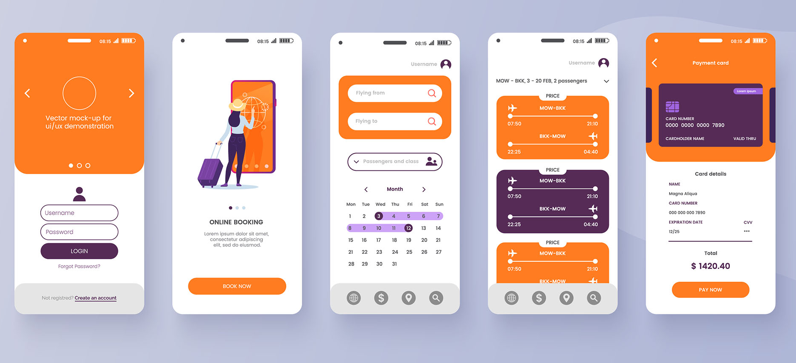
Web/User Interface design

Slide 23
Types of Graphic Design
Illustration design:
Illustration is the artsy and creative side of graphics design. It’s what an art major or someone who loves drawing might consider. It involves creating original, bespoke artwork for various mediums. These can range from book covers and product labels to t-shirt design ideas and social media ads.

Slide 24
Illustration design
children’s books
t-shirts and other wearables
cards and stationary
social media
video and interactive media
marketing campaigns

Slide 25
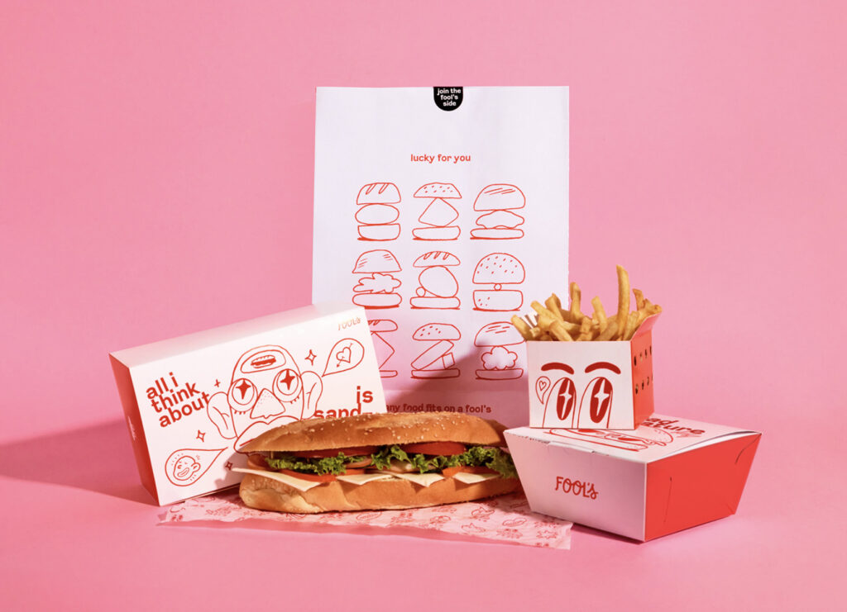
Illustration design

Slide 26
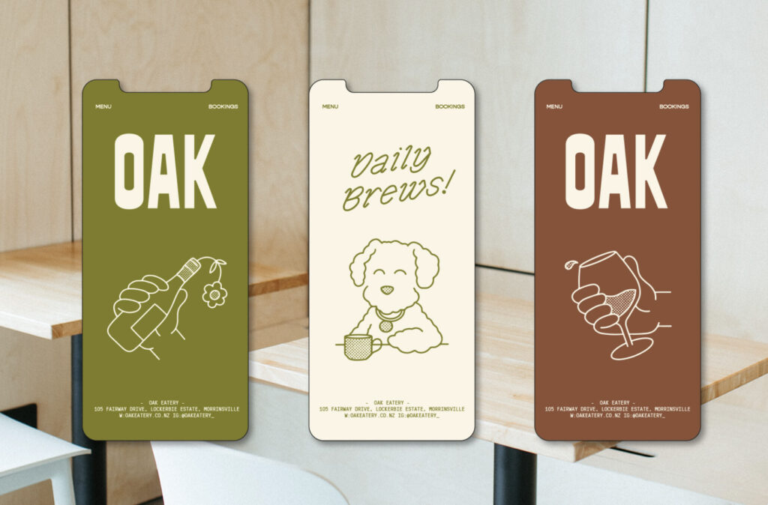
Illustration design

Slide 27
Types of Graphic Design
Packaging Graphic Design:
This involves creating attractive and informative packaging design for products. The design usually includes the company’s logo, product information, and other branding elements. The goal is to convey the brand personality and distinguish the brand packaging from other products.

Slide 28
5. Package design
Create mockups to illustrate a 3D product from all sides
Placement and configuration of logo, text, and design elements
Working with the material, colors, and physical limitations of the product
Make packaging on-brand, and distinguishable

Slide 29
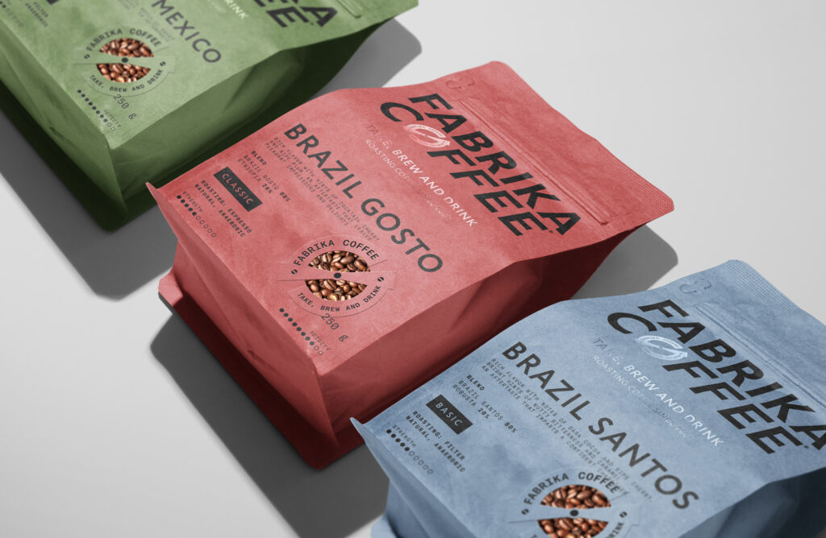
Packaging design

Slide 30
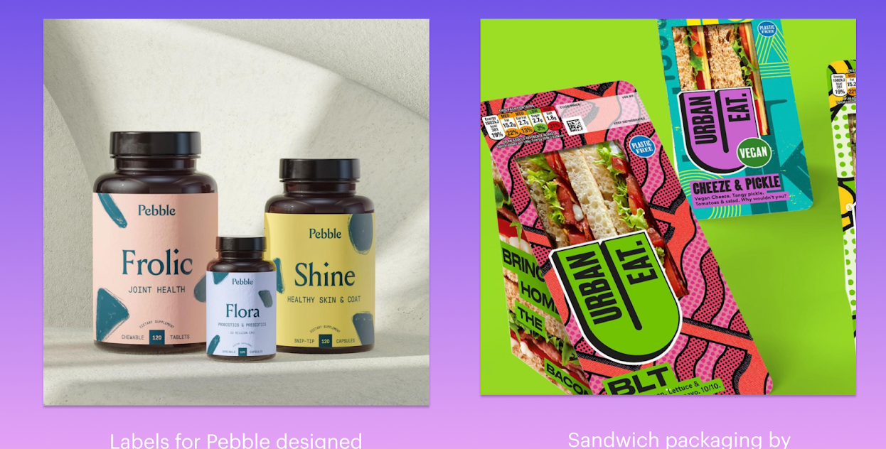
Packaging design

Slide 31
Types of Graphic Design
Editorial design:
It is a very important part of both print and digital editorial publications. Editorial graphic design helps set the tone for a publication and can amplify the written word. This involves designing the layout and visual design aesthetics of print materials like books, newspapers, magazines, and catalogs. The main goal is to enhance readability, engagement, and, of course, make an impression.

Slide 32
Editorial design
books
magazines
newspapers
emails and digital publications
Create a layout and composition using grids
Color matching and cohesion of imagery
Selection and placement of typography, including sizing.
Choosing and placing photography and visual elements

Slide 33
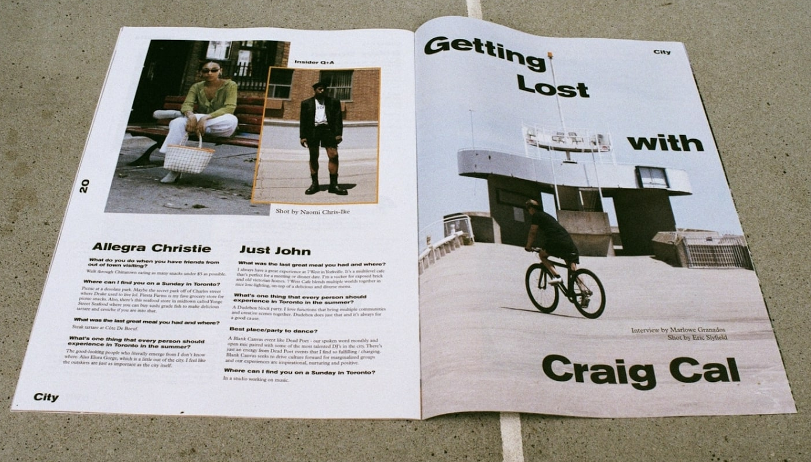
Editorial design

Slide 34
Applications for Graphic Design
CorelDRAW

Slide 35
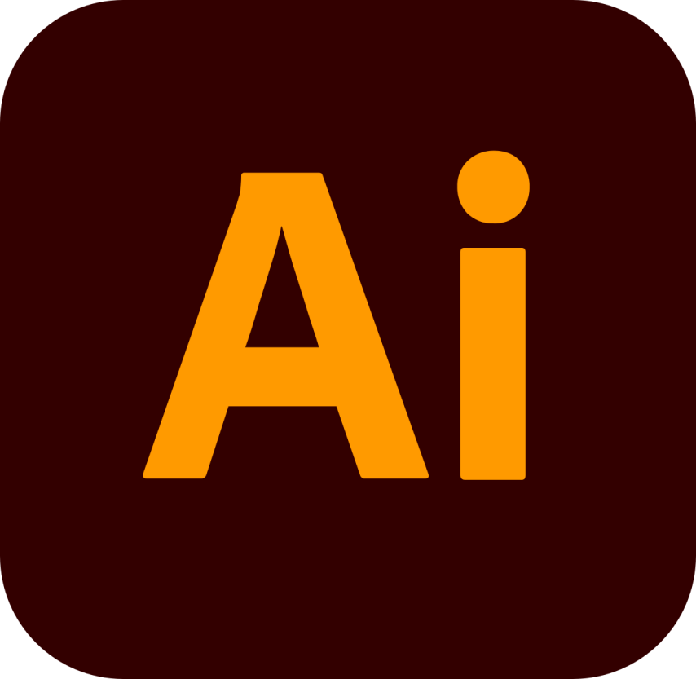
Applications for Graphic Design
Adobe Illustrator

Slide 36
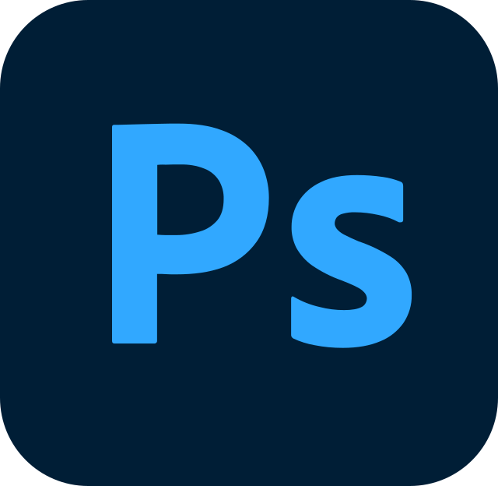
Applications for Graphic Design
Adobe Photoshop

