Slide 1
WORKING WITH FONTS, ICONS AND IMAGES
Graphic and Web Design Class

Slide 2
Introduction
TYPEFACE: This is the font family e.g Arial, Roboto, Montserrat
FONT: This is the style of text in the font family e.g Arial Bold

Slide 3
Useful Font Terminology
Serif
San Serif
Script (or Handwriting)
Display
Monospace

Slide 4
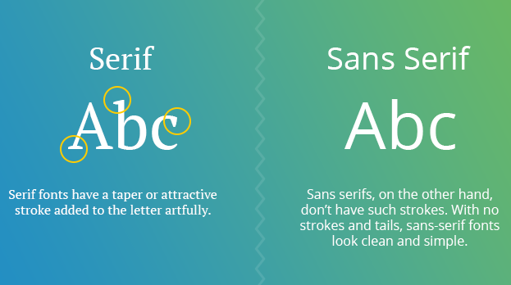
Serif vs. San Serif

Slide 5
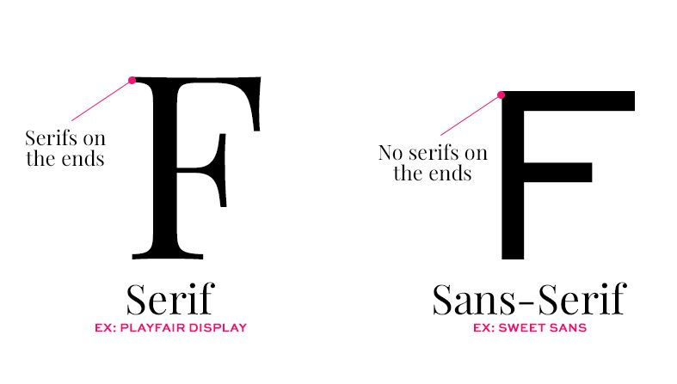
Serif vs. San Serif

Slide 6
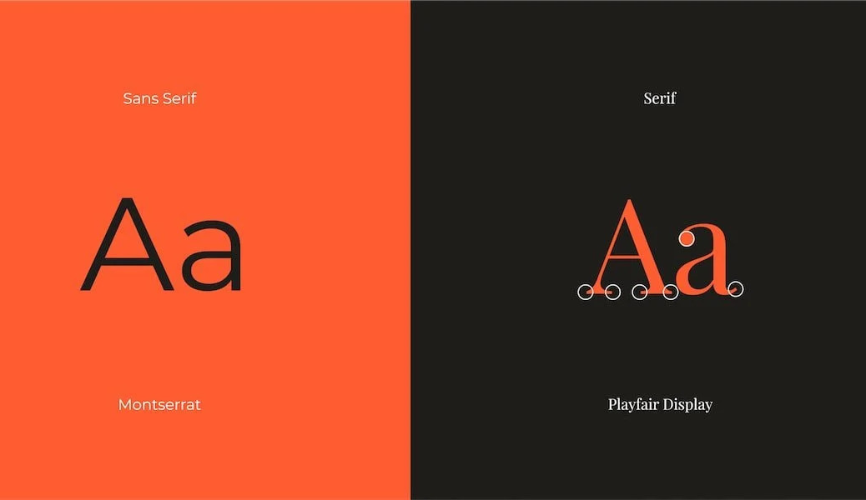
Serif vs. San Serif

Slide 7

Serif vs. San Serif

Slide 8
Characteristics of Serif
Sophisticated
Formal
Elegant
Established
Classic

Slide 9
Characteristics of San Serif
Modern
Friendly
Clean
To the point

Slide 10
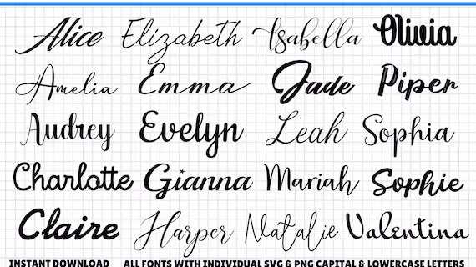
Script / Handwriting

Slide 11
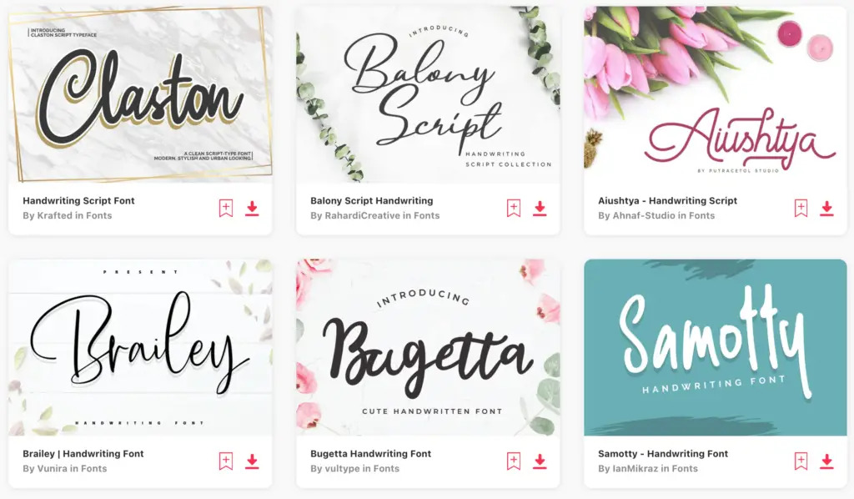
Script / Handwriting

Slide 12
Characteristics of Script
Personalized
Light hearted
Creative
Fun
Elegant
Classy
Luxurious

Slide 13
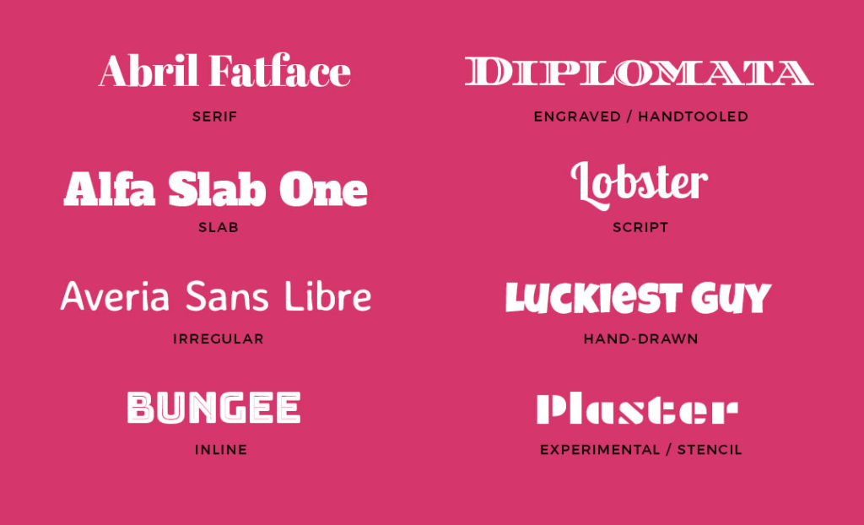
Display Font

Slide 14
Characteristics of Display Font
Bold
Interesting
Unique
Tech Edu

Slide 15
Font pairing tips
Use only 1 or 2 fonts:
Small Title
Several paragraphs of randomly generated text will appear.
Small Title
Several paragraphs of randomly generated text will appear.
Small Title
Several paragraphs of randomly generated text will appear.
Small Title
Several paragraphs of randomly generated text will appear.

Slide 16
Font pairing tips
Use 2 noticeably different fonts:
Small Title
Several paragraphs of randomly generated text will appear.
Small Title
Several paragraphs of randomly generated text will appear.
Small Title
Several paragraphs of randomly generated text will appear.
Small Title
Several paragraphs of randomly generated text will appear.

Slide 17
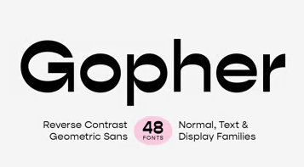
Other fonts pairing tips
Contrast font sizes

Slide 18
Helpful resources for font
www.fonts.google.com/
www.dafont.com/
www.1001fonts.com/
www.fontsquirrel.com/

Slide 19
What is Icon
Icon is a small graphical representation of a program or file. Icons help users quickly identify the type of file represented by the icon.
Icon comes to us from the Greek word eikenai, meaning "to seem or to be like." Icon can also describe an object closely linked to an idea.

Slide 20
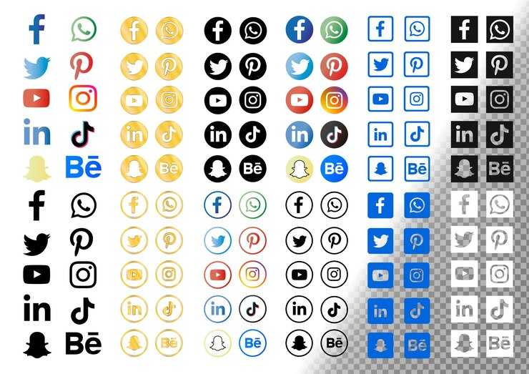
What is Icon

Slide 21
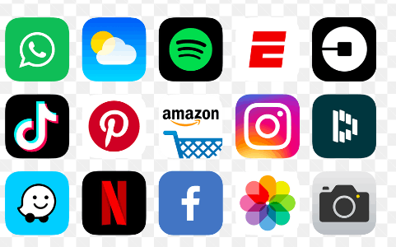
What is Icon

Slide 22
Tips in using Icon
Use icons that are universally popular.
Always use text label to accompany icons that are not popular

Slide 23






Styles of Icon
Filled Icon:

Slide 24





Styles of Icon
OutlinedIcon:

Slide 25
Helpful resources for Icons
www.fonts.google.com/
www.flaticon.com/
www.iconfinder.com/
www.iconscout.com/
www.svgrepo.com/

Slide 26
What is Images
Imagery is a visual representation of items, people, scenery, and ideas through photos, illustrations, drawings, and graphics. In graphic design, images are part of visual language, which helps communicate information quicker than text.
Graphic design images often use stock images in their work. Stock images are ones that are free for public use or cost a small fee, and include a wide variety of subject matter for graphic designers to use.

Slide 27

What is Image

Slide 28

What is Image

Slide 29
Helpful resources for Images
www.freepik.com/
www.unsplash.com/
www.pixabay.com/
www.pexels.com/

