Slide 1
PRINCIPLES OF DESIGN
Graphic and Web Design Class

Slide 2
Introduction
Good design is possible without understanding the principles of design. But it may take a lot of trial and error to create something that both looks good and creates an optimal user experience.
The principles of design are a set of rules that designers can follow when creating a composition to create visually pleasing work. The purpose of these rules is to deliver a message in the most organized and functional way.

Slide 3
Principles of Design
Balance:
All design elements and principles—typography, colors, images, shapes, patterns, etc.—carry a visual weight. Some elements are heavy and draw the eye, while other elements are lighter. The way these elements are laid out on a page should create a feeling of balance.
It’s like putting two objects on a seesaw: If one side is too heavy, the viewer’s eye goes directly to the heavy part. If it’s weighted with all things equal, the seesaw is perfectly suspended without either side touching the ground.

Slide 4
Balance

Slide 5
Balance

Slide 6
Unbalance of two objects of different weight

Slide 7
Principles of Design
Alignment:
Alignment is a design principle that refers lining up text or graphics on a page.
A design with poor alignment will look cluttered and unfinished. But aligning elements on the page will organize your design and make it easier to read.

Slide 8
Types of Alignment
Left Alignment: Left alignment is when elements are aligned to the left side of the page.

Slide 9
Types of Alignment
Right Alignment: Right alignment is when elements are aligned to the right side of the page.

Slide 10
Types of Alignment
Vertical Alignment: Vertical alignment is when elements are centerly aligned with the top of the page.

Slide 11
Types of Alignment
Center Alignment: Center alignment is when elements are aligned with the center of the page.

Slide 12
Principles of Design
Hierachy:
Hierarchy is a way to visually rank your design elements. Hierarchy is not based on a design styles, but rather the order of importance. A good design leads the eye through each area in priority order.
The headline is the most important thing on the page so you can identify what you’re reading.

Slide 13
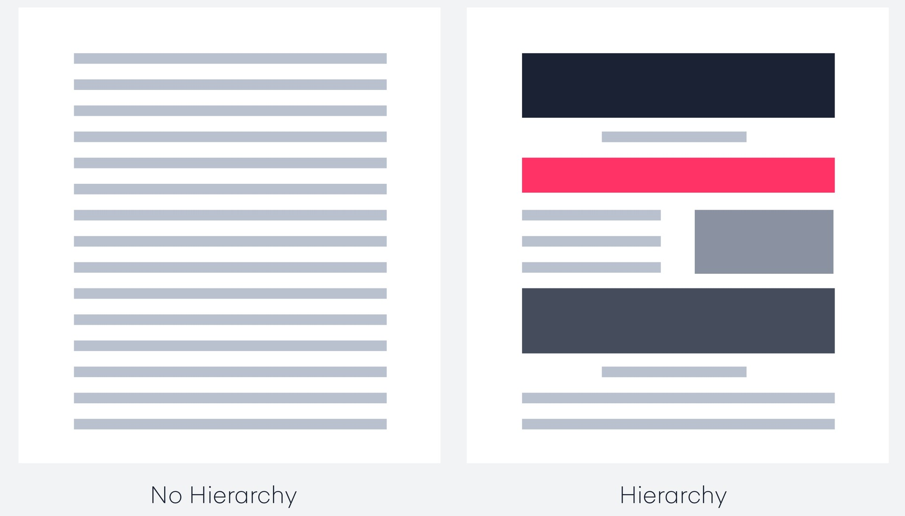
Hierarchy

Slide 14
Hierarchy

Slide 15
Principles of Design
Contrast:
Contrast in graphic design occurs when visual elements placed close together noticeably differ from each other.
The difference between two or more objects in a design is referred to as contrast. The difference in objects could be light and dark, thin and thick, small and large, bright and dull, etc.

Slide 16
Types of Contrast
Contrast of size: This will help you establish the key elements in your layout so the viewer is focus on the right area. Contrast of size is not applicable to just text; it can also be the images in the design.

Slide 17
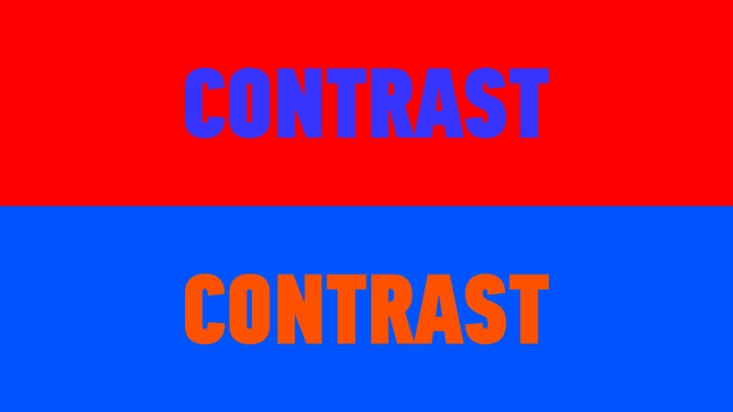
Types of Contrast
Contrast of color: Establishing the right contrast of colors can make or break your design. You don't want colors to conflict with each other in such a way that it's confusing and irritating to look at.

Slide 18
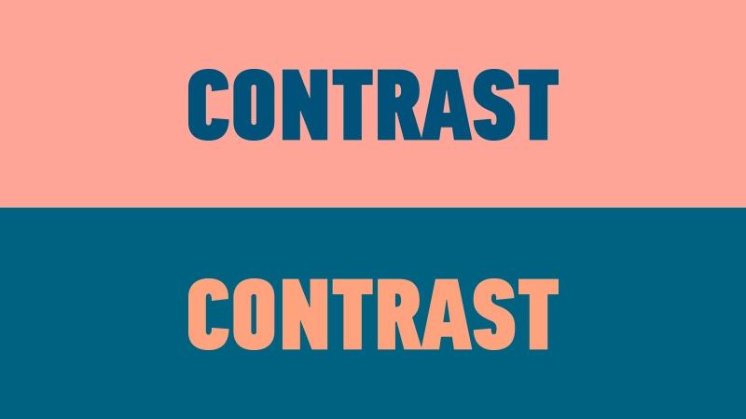
Types of Contrast
Contrast of color: Establishing the right contrast of colors can make or break your design. You don't want colors to conflict with each other in such a way that it's confusing and irritating to look at.

Slide 19
Types of Contrast
Contrast of shape: Utilizing contrast in shape will allow you to deepen the level of contrast to attract more attention to an area. For instance, if you have a layout where all of the elements are made up of rectangles, but right in the middle there's a circle, the viewer's attention is going to go directly to the circle because it's different from the rest of the elements.

Slide 20
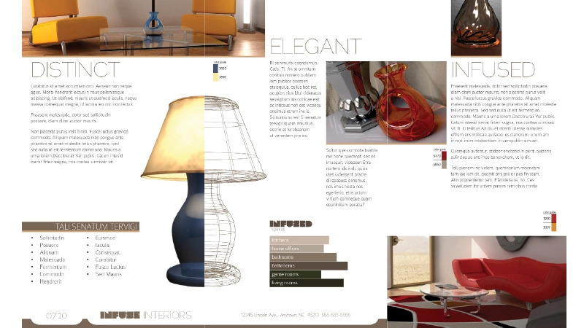
Contrast

Slide 21
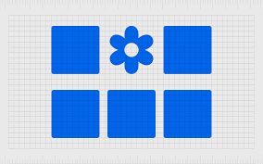
Contrast

Slide 22
Types of Contrast
Contrast of Type: Contrast of type concerns font. No matter what design you're creating, chances are you'll be working with some type of font. When it comes to typefaces, the other elements of contrast can all be applied, whether it's color, size or shape.

Slide 23
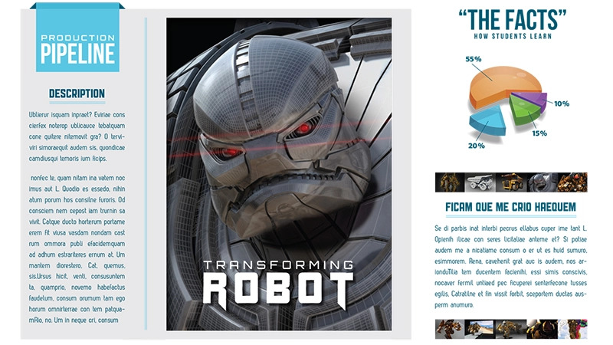
Contrast

Slide 24
Understanding Colour Psychology
Meaning of Color: The property possessed by an object of producing different sensations on the eye as a result of the way it reflects or emits light. The quality of an object or substance with respect to light reflected by the object, usually determined visually by measurement of hue, saturation, and brightness of the reflected light.

Slide 25
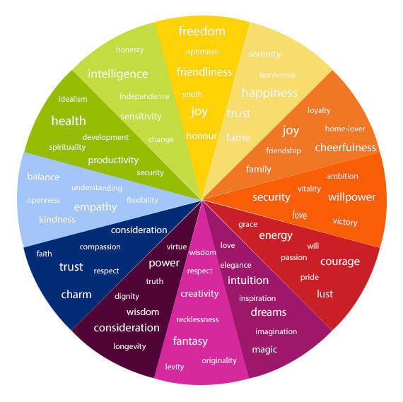
Color Meaning

Slide 26
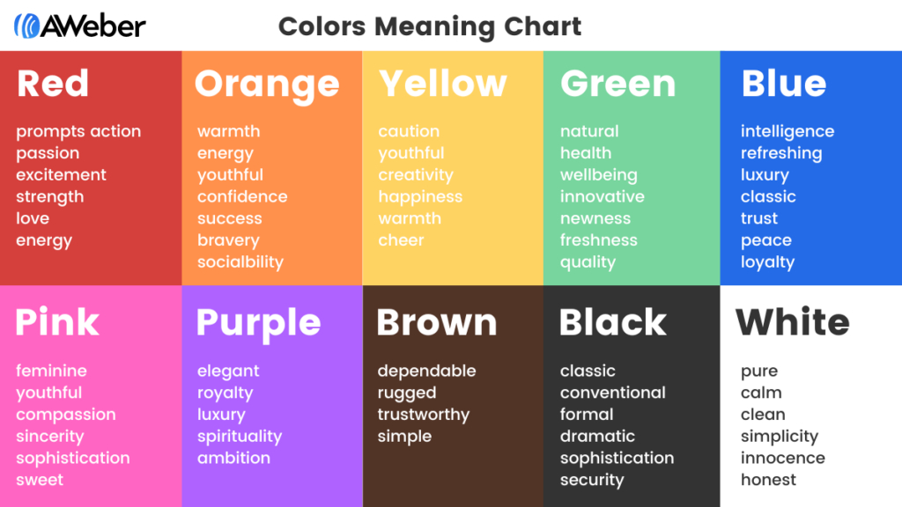
Color Meaning

Slide 27
Types of Colour mixing Model
RGB: Additive color mixing model:
Red, Green, Blue: It is used for digital graphic design project, such as flyers, banner, web design, online design and other digital-only files. RGB IS USED FOR DIGITAL GRAPHICS PROJECT. It ranges from 0 - 255
RED + GREEN + BLUE = WHITE (255 + 255 + 255)
RED + GREEN + 0 BLUE = YELLOW (255 + 255 + 0)
0 RED + GREEN + BLUE = SKY BLUE (0 + 255 + 255)
RED + 0 GREEN + BLUE = PURPLE (255 + 0 + 255)

Slide 28
Types of Colour mixing Model
CMYK: Subtractive color mixing model:
CYAN, MAGENTA, YELLOW, BLACK: Any color you see on a physical surface (Paper, signage, package, photos, magazine etc.) uses the subtractive color mixing model.

Slide 29
Colour Theory
Color theory explains how humans perceive color and the visual effects of how colors mix, match or contrast with each other.
Color theory also involves the messages color communicate.
In color theory, colors are organized in a color wheel and grouped in 3 categories: Primary colors, Secondary colors and Tertiary colors.

Slide 30
Colour Wheel
The color wheel shows the relationship between colors.
There are 12 main colors on the color wheel. In the RGB color wheel, and it can be divided into primary, secondary and tertiary colors
Primary Colors: (Red, Yellow and Blue)
Secondary Colors: They are created when primary colors are mixed (Green, Orange and Purple)
Tertiary Colors: They are made from primary and secondary colors.

Slide 31
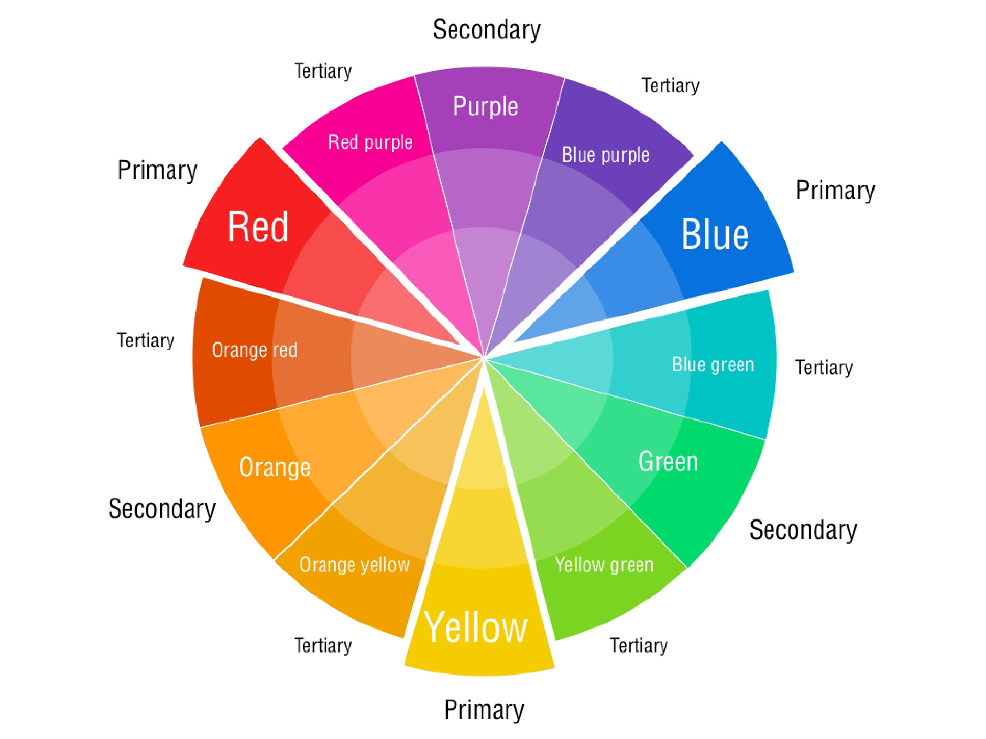
Colour Wheel

Slide 32
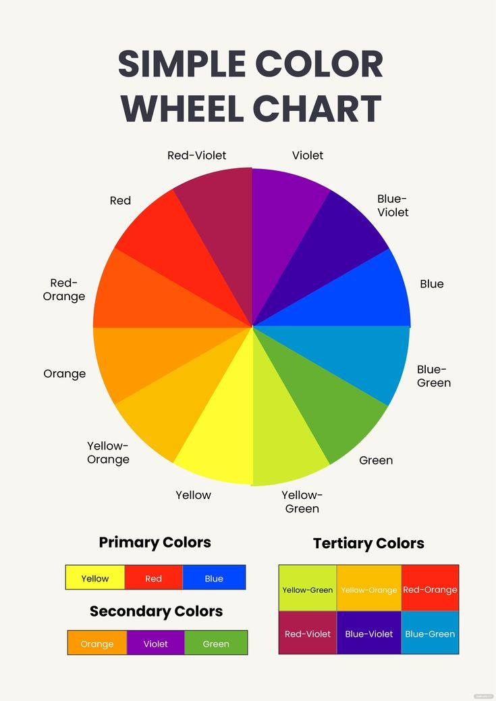

Slide 33
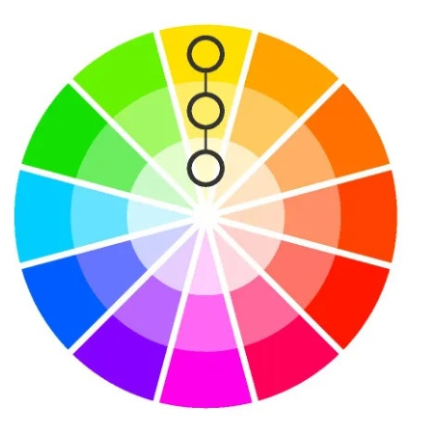
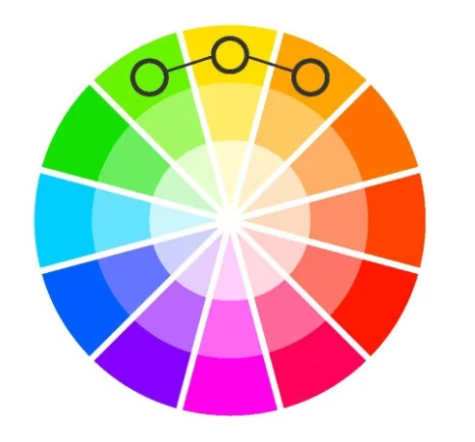
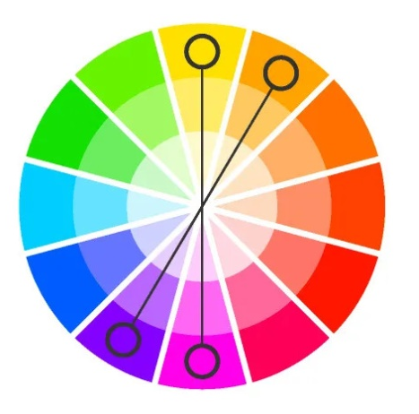
Colour Scheme
Monochromatic
Analogous
Complementary
Split Compl.
Triadic
Tetradic
Square

Slide 34
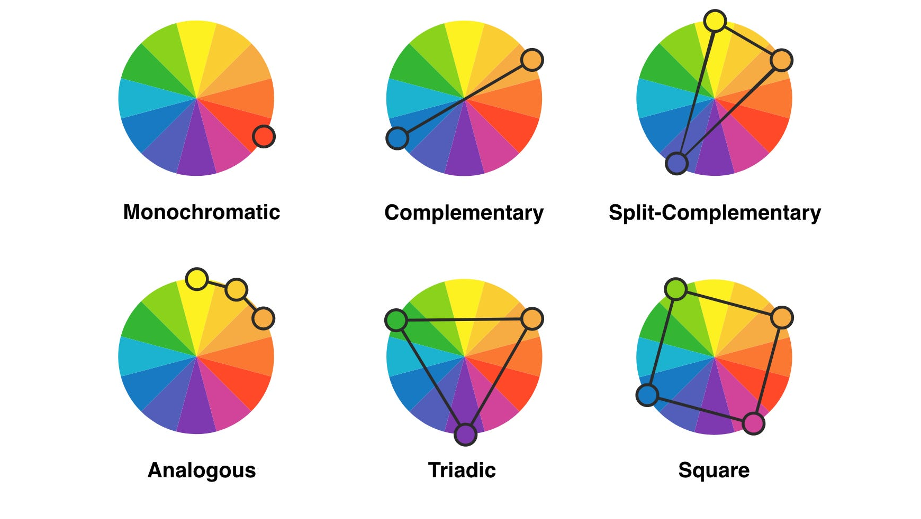
Colour Scheme

